Slide 1

PROJECT NAME : Smart Water Fountain
TEAM NAME : Proj_224781_Team_3
TEAM MEMBERS :
UDAY PRATAP V M (113321104103)
VADDIBOINA PATTABHIRAMI REDDY (113321104105)
VAKATI VIKRAM ADITYA REDDY (113321104109)
VATRAPU VISHNU VARDHAN REDDY (113321104111)

Slide 2
INNOVATION:
The project involves implementing IoT sensors to monitor water consumption in public places such as parks and gardens. The objective is to promote water conservation by making real-time water consumption data publicly available.
This project includes defining objectives,designing IoT sensor system developing the data sharing platform and integrating them using IoT technology and python.
Deploy a network of IoT sensors and devices throughout the water distribution network, including water treatment plants, reservoirs, pipelines, and consumer premises.
Collect real-time data from the sensors and devices, providing a comprehensive view of the entire water system's status.
Use wireless communication protocols (e.g., LoRaWAN, NB-IoT) to transmit data securely and efficiently.

Slide 3
OBJECTIVES:
The smart water system using IoT is an innovative solution that leverages the IoT for management and conservation of water resources.
Water management problems such as water usage ,overflow in water tank. To overcome this problem by implementing proper monitoring.
Through a network of sensors, the system collects real-time data on water quality and consumption. This data is processed in cloud based platform.
It highlights potential of IoT in revolutionizing water management practices, ensuring sustainable access to clean water for current and future generations.
These sensors will continuously monitor parameters such as water flow rate, pressure, temperature, pH levels, turbidity, and contaminants.

Slide 4
IoT SENSOR DESIGN:
There are several IoT sensors and components that are used in the smart water system using IoT. Some of them are as follows.
1.Ultrasonic sensor: It is used to indicate the level of water in real time. When the water level falls below the threshold level the motor will automatically ON.
2. Temperature sensor: It is used to sense the temperature in water tank.
3. Water flow Sensor: It is used to know the usage of water litre per hour. By using ESP8266 WI-FI module the data is recorded in real-time and updated in cloud.

Slide 5
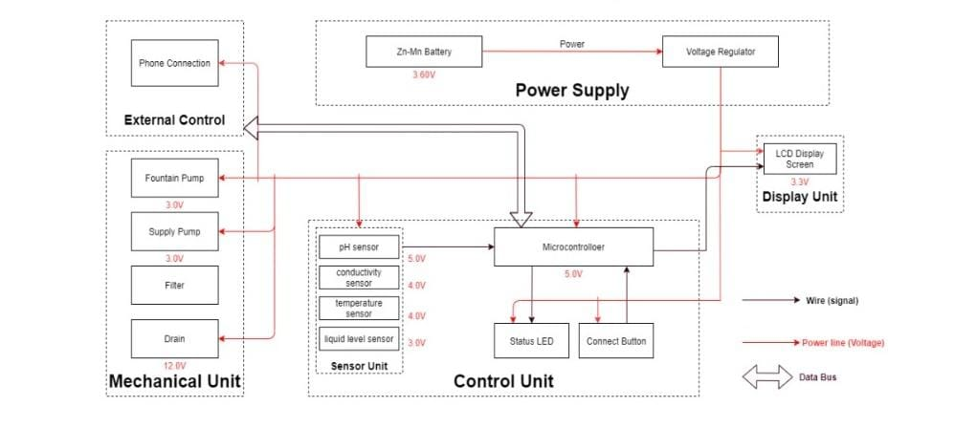

Slide 6
Design Features:
Fountains wirelessly communicate with base stations
Base stations collect and transmit usage, filter, and system health information to the cloud via Ethernet
Wireless communications use a low-power unlicensed band for improved security and power savings

Slide 7

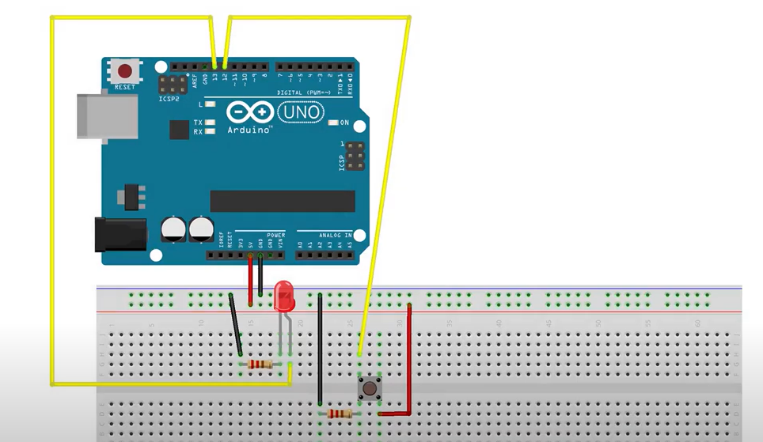
Code Implementation:
Connection Indication Code:

Slide 8
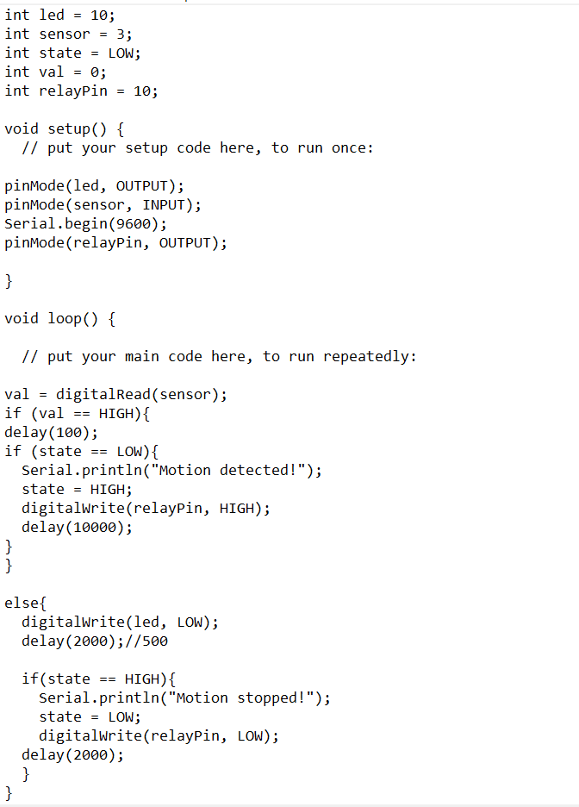
PIP Sensor Indication:

Slide 9
Conclusion:
Smart water fountains using IoT technology represent a significant leap in modern water management. These innovative fountains offer real-time monitoring, data analysis, and remote control capabilities, making them efficient and sustainable water sources. By combining IoT sensors and connectivity, they contribute to reduced water wastage, enhanced user experience, and better resource management. As the adoption of IoT-driven smart water fountains grows, they have the potential to positively impact public health, the environment, and urban infrastructure, highlighting their importance in building a smarter, more sustainable future.

Slide 10
THANK YOU

